Slide 1
CS523-BDT-Final Project on SOCCOR ANALYSER
Submitted By:
PUSKAR BUDHATHOKI, Mhreteab Adhanom Berhe , Natnael Berhe
Submitted To: Prof. Mrudula Mukadam

Slide 2
Project Overview
Dataset: we have used International Football Results from 1872 to 2023 dataset from popular website kaggle (https://www.kaggle.com/datasets/martj42/international-football-results-from-1872-to-2017?datasetId=4305)
Kafka: Distributed messaging system which is used for streaming analytics and data integration(Demo Project)
Spark: It is used for getting the dataset and performing some filter and aggregation
HBase: The enriched result is saved in Hbase/Hive.

Slide 3
Project Overview

Slide 4
Technology stack used
Kafka – xxx
Spark streaming – 2.4.4
Spark core – 2.4.4
Java - 8
Hadoop – 2.6.0
Hbase/Hive – xxx

Slide 5
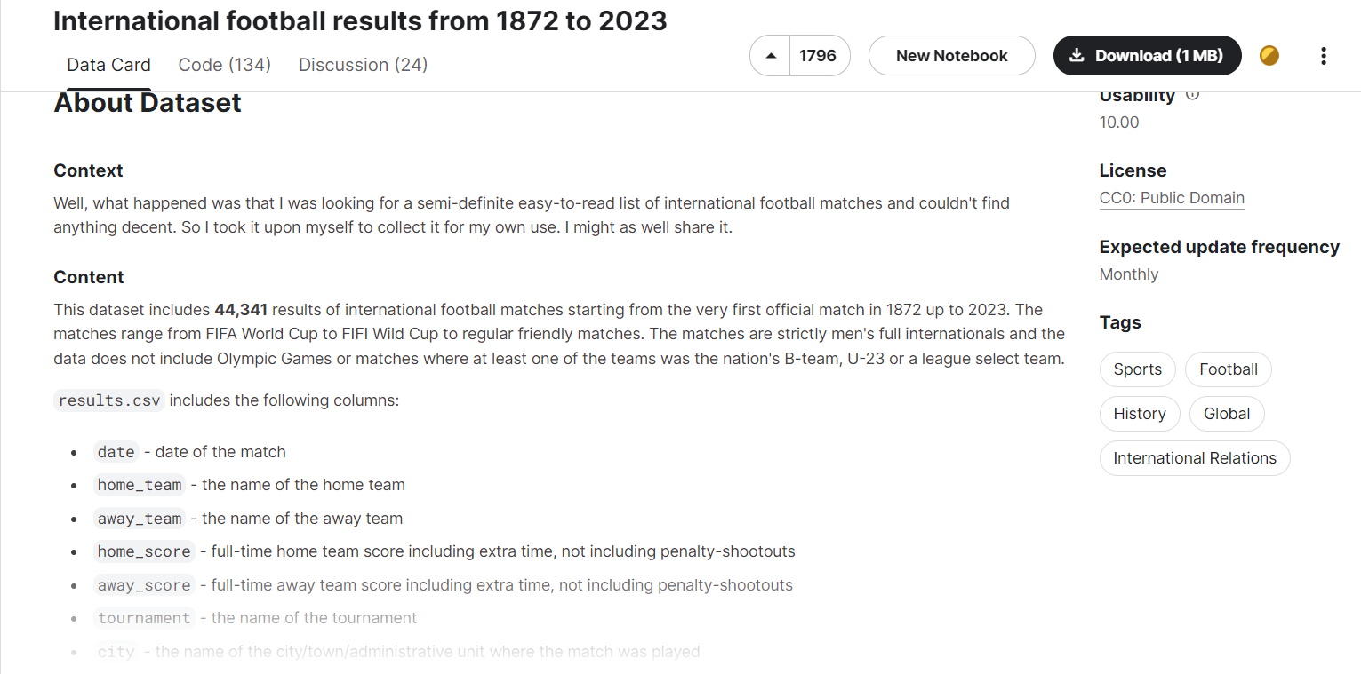
Dataset used
Used static football dataset from kaggle
https://www.kaggle.com/datasets/martj42/international-football-results-from-1872-to-2017?datasetId=4305
Created a program to split the whole dataset into smaller datset to use apache data streaming

Slide 6
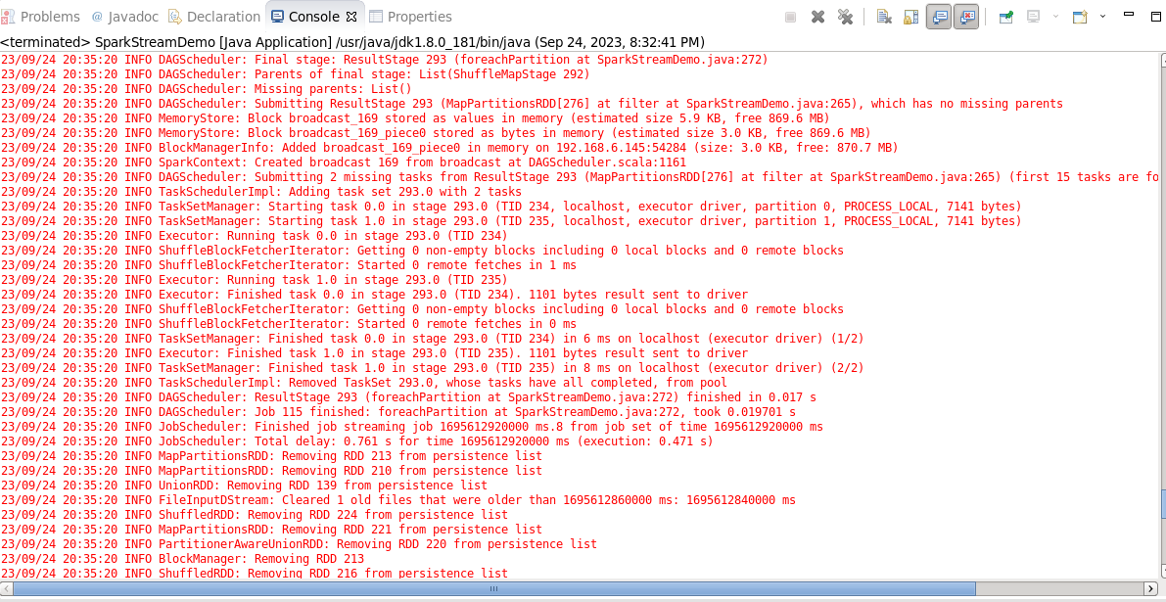
Apache Data Streaming sample
Received csv file as text stream input and allocate infrastructure to complete the allocated jobs
Fig 2: Apache data stream console

Slide 7

Apache Kafka
Consist xxx brokers (Kafka cluster) and manage by zookeeper
Detail description and screenshot goes here

Slide 8

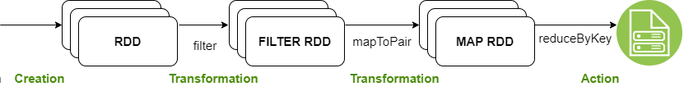
Spark Streaming
Get international football statistics from the split dataset
Filter required columns like home_team, away_team, home_goal, away_goal, city, match_type etc
Calculate total scores by each country, frequency of match type, organizing city with frequency
Filter data based on threshold values for different use cases
Text Stream

Slide 9

Apache HBASE/Hive
The output data from spark (aggregated) is persist in Hbase/Hive database
Detail description and screenshot goes here

Slide 10
Demo steps
Step 1:
Created a account in kaggle (https://www.kaggle.com/)
Downloaded static dataset related to international football
Step 2:
Download Kafka from https://archive.apache.org/dist/kafka/
Extract at opt i.e. /opt/kafka_2.11-1.1.0
Run Zookeeper : bin/zookeeper-server-start.sh config/zookeeper.properties
Since we will have 3 servers, it’s better to maintain 3 configuration files for each server. Copy the config/server.properties file and make 3 files for each server instance
cp config/server.properties config/server.1.properties cp config/server.properties config/server.2.properties cp config/server.properties config/server.3.properties

Slide 11
Demo steps (Continue..)
Change the above 3 properties for each copy of the file so that they are all unique.
server.1.properties broker.id=1 listeners=PLAINTEXT://:9093 log.dirs=/tmp/kafka-logs1 server.2.properties broker.id=2 listeners=PLAINTEXT://:9094 log.dirs=/tmp/kafka-logs2 server.3.properties broker.id=3 listeners=PLAINTEXT://:9096 log.dirs=/tmp/kafka-logs3

Slide 12
Demo steps (Continue..)
Create the log directories that we configured:
Finally, we can start the broker instances. Run the below three commands on different terminal sessions:
mkdir /tmp/kafka-logs1 mkdir /tmp/kafka-logs2 mkdir /tmp/kafka-logs3
bin/kafka-server-start.sh config/server.1.properties bin/kafka-server-start.sh config/server.2.properties bin/kafka-server-start.sh config/server.3.properties

Slide 13
Demo steps (Continue..)
Creating Topics
bin/kafka-topics.sh --create --topic TWEET --bootstrap-server localhost:9093 --partitions 3 --replication-factor 2 bin/kafka-topics.sh --create --topic TWEET_HBASE --bootstrap-server localhost:9093 --partitions 3 --replication-factor 2

Slide 14
Demo steps (Continue..)
Step 3:
Run the Twitter Kafka Producer Application
It fetches tweets from twitter API and produce to Kafka cluster on topic TWEET
Step 4:
Run the Spark Kafka Application(Spark Streaming) which aggregation/filter tweets and produce Kafka cluster on topic TWEET_HBASE
Step 5:
Run the twitter-hbase which store process data to HBase datastore.

Slide 15


